Slide 1


MusiCloud
Team 3
Michael Danilson 1002069595
Abhinav Shashank Choudhary – 1002039179

Slide 2
Intro
Simple music player
Basic music features
Upload your own songs
Simple cloud file storage interface
Good for large, eclectic collection

Slide 3
Requirements
The app is run from a website and so will require internet access
The site will be compatible with a standard modern web browser (Edge, Chrome, Firefox, etc.)
Users will need to create accounts to access the site and its services
The site will act as a cloud file hosting service
Users can upload files
Users can rename & delete files
The site will play the music files uploaded
Play/pause, next/prev track or file
Progress bar during playback
Users can organize their songs and tracks into playlists
Users can mark songs and track as favorites

Slide 4
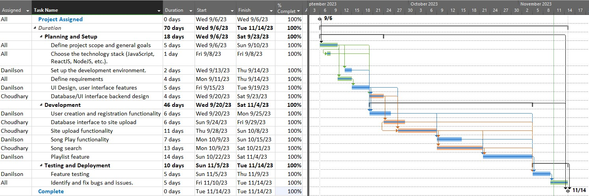
Schedule

Slide 5
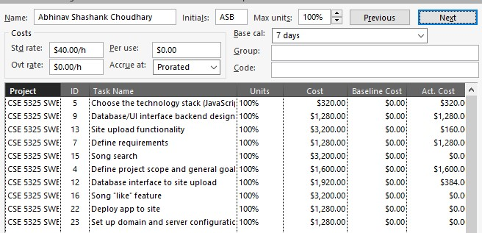
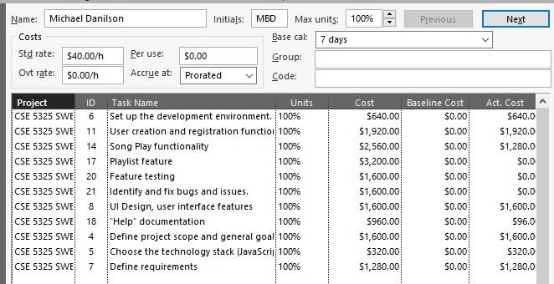
Task Allocation

Slide 6
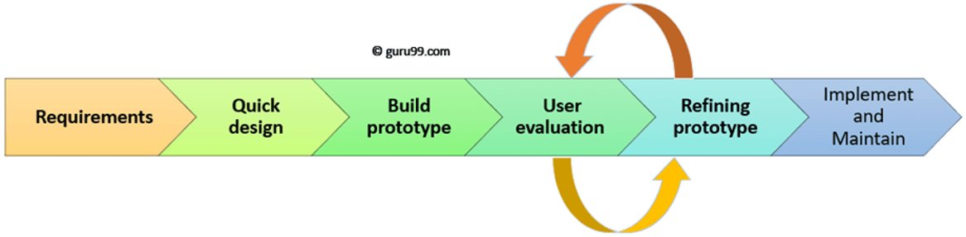
Model - Prototyping

Slide 7
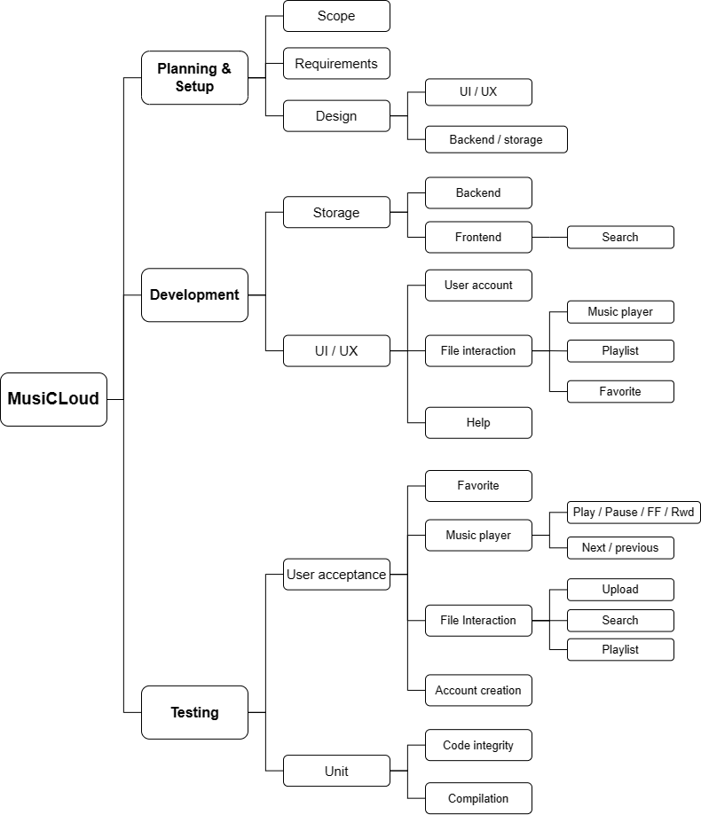
WBS

Slide 8
Estimation - COCOMO
Measurement Parameter | Count | Simple | Total
Number of user inputs | 4 | 3 | 12.00
Number of user outputs | 3 | 4 | 12.00
Number of user inquiries | 1 | 3 | 3.00
Number of files | 20 | 7 | 140.00
Number of external interfaces | 0 | 5 | 0.00
Total |  |  | 167.00
Function points calculated: 143.62
LOC based on “4GL” (4th generation languages)
20 LOC/FP average: 2872.4 KLOC
Software Project Complexity | A_{b} | B_{b} | C_{b} | D_{b}
Organic | 2.4 | 1.05 | 2.5 | 0.38
Effort (E) = a_{b}(KLOC)^{b}_{b} = 7.27 Person Months Duration (D) = c_{b}(E)^{d}_{b} = 5.31 Months
Personnel = 7.27 / 5.31 = 1.4 persons, ~2 person team

Slide 9
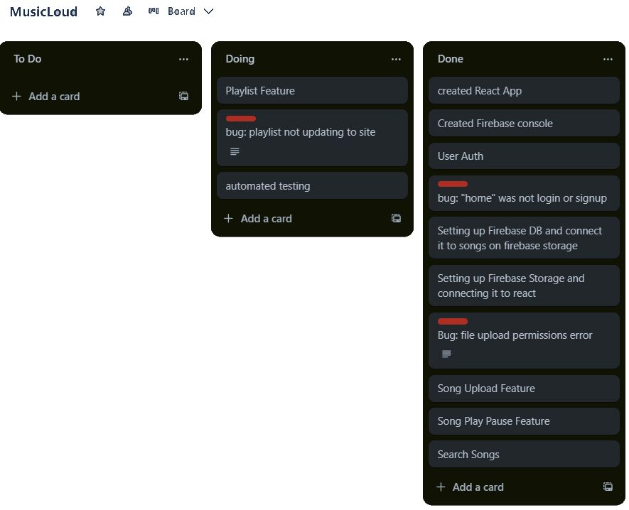
Task Tracking

Slide 10
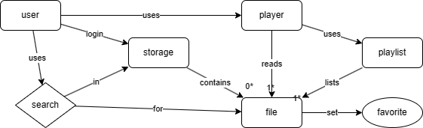
ER Diagram

Slide 11
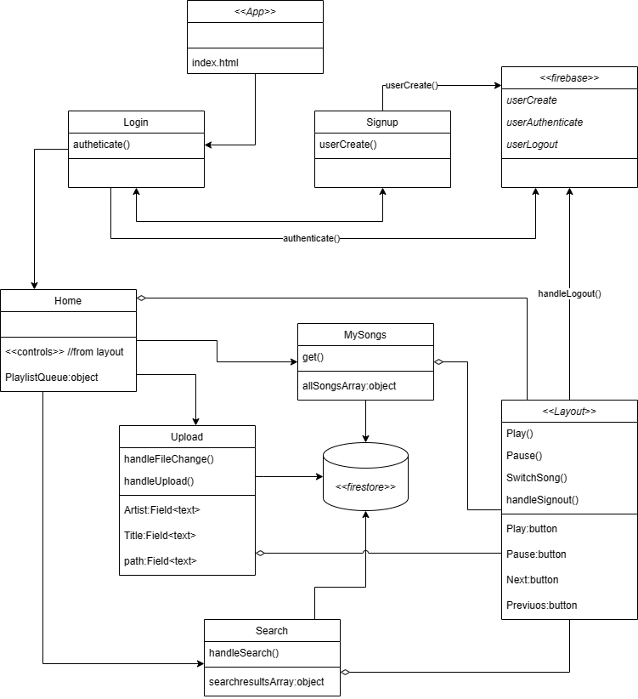
Class Diagram

Slide 12
Implementation
Environment
VSCode
Github
Tools
React
Javascript
Firebase

Slide 13
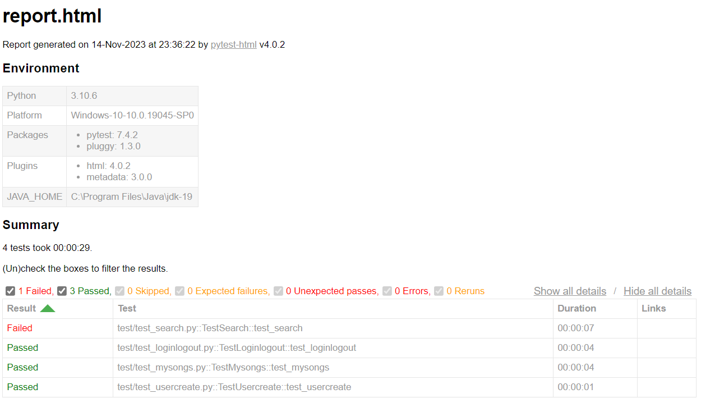
Tests
Manual
Automated
Category | Expected Result | Actual Result | Pass/Fail
Sign up | User presented with the “Sign up” screen to enter new credentials | User was directed to the sign-up screen with entry fields | Pass
Valid Registration | User is directed to login screen | User directed to login screen | Pass
Invalid Registration | User presented with error | User is presented with error | Pass
Sign in | User redirected to Login screen (/login) | User is directed to Login screen | Pass
Valid login credentials | User is directed to the home front page (/home) | User directed to the home screen correctly | Pass
Invalid login credentials | User is presented with error message of invalid credentials | Error message was displayed correctly | Pass
Search | User should be able to see the list of songs that has the search query term in the title of the song. | The search result shows the list of the song with the searched term in the name. | Pass

Slide 14
Maintenance
Security improvements
Verification
Password reset
UI Improvements
Playlist
Favorite
Visual display (album art)
File control improvements
Offline play

Slide 15
Future Scope
Mobile App
Store front, music purchase
Storage purchase
Self hosting
Social media interactions

Slide 16

DEMO

Slide 17

Questions

